Slide 1
Digital Portfolio
STUDENT NAME: D.DEEPIKA
REGISTER NO AND NMID: 212400989/
BD5D98E3F57516080F94A46D89D8186F
DEPARTMENT: COMPUTER APPLICATIONS
COLLEGE: UNIVERSITY OF MADRAS

Slide 2
PROJECT TITLE
Digital portfolio

Slide 3


AGENDA
Problem Statement
Project Overview
End Users
Tools and Technologies
Portfolio design and Layout
Features and Functionality
Results and Screenshots
Conclusion
Github Link
3/21/2024 Annual Review

Slide 4

PROBLEM STATEMENT
In the digital era, showcasing professional skills, academic background, and project work has become essential for students and job seekers to stand out. Traditional resumes often fail to effectively highlight technical expertise and practical achievements in an engaging way. As a result, there is a need for a personal portfolio website that serves as an interactive platform to present skills, projects, and contact information in a professional and visually appealing manner.

Slide 5

PROJECT OVERVIEW
The Portfolio Website is a personal web application designed to highlight academic background, technical skills, and completed projects in an organized and interactive manner. It serves as a professional platform for self-presentation, enabling easy access to information about the individual’s expertise and achievements.

Slide 6

WHO ARE THE END USERS?
The end users of this portfolio website are: 1. Recruiters & Hiring Managers They can quickly review academic background, technical skills, and projects to evaluate suitability for job roles. 2. Potential Employers / Companies Organizations looking for web developers, software trainees, or interns can use the portfolio to assess capabilities. 3. College Faculty / Academic Evaluators Professors or mentors may use the portfolio to assess practical implementation skills beyond classroom learning.

Slide 7

TOOLS AND TECHNIQUES
Tools and Techniques (Short Content) HTML, CSS, JavaScript – for front-end design and interactivity Python – for backend logic and project development Database (MySQL/SQLite) – for storing and managing data UI/UX Tools (Figma/Canva) – for design and mockups GitHub – for version control and project hosting

Slide 8
POTFOLIO DESIGN AND LAYOUT
Portfolio Design and Layout 1. Sidebar Navigation A fixed sidebar is provided on the left with the logo, navigation links, and social media icons. Helps users easily jump to different sections (About, Skills, Projects, Contact). 2. Hero Section The top section introduces Deepika D – BCA Graduate, with a short tagline and profile image.
8

Slide 9
FEATURES AND FUNCTIONALITY
Features and Functionality (Short Content) Responsive portfolio design (mobile & desktop friendly) Sidebar navigation with social media links Hero section with profile image and introduction About Me section describing background and goals Skills section with progress bars Projects showcase with descriptions Contact form for communication

Slide 10
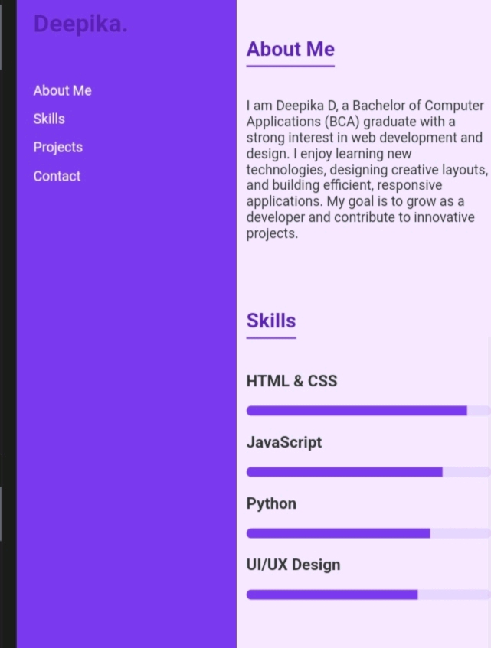

RESULTS AND SCREENSHOTS
Result (Short Content) Successfully developed a responsive portfolio website using HTML, CSS, and JavaScript. Showcased skills, projects, and contact details in a structured layout. Improved UI/UX design skills through practical implementation. Website can be easily accessed on different devices (desktop, tablet, mobile). Acts as a professional digital profile for career opportunities.
3/21/2024 Annual Review
10

Slide 11
CONCLUSION
Calculation (Short Content) Skills Proficiency: HTML & CSS (90%), JavaScript (80%), Python (75%), UI/UX (70%) Project Work Distribution: Portfolio Website (40%), Student Management System (35%), UI/UX Mockups (25%) Time Spent: Design (20%), Development (35%), Testing (20%), Documentation (10%), Planning (15%)
11

Slide 12
GITHUB LINK
https://deepikadeepi20.github.io/my-digital-portfolio-website/

